Slide 1
Retinopathy Survival Analysis
Anthony Castillo
Xin Chen
Vanessa Ho
Group number: 21

Slide 2
Overview of Data
We have obtained our data set “Diabetic Retinopathy” from the built in data within the Survival package, This data set includes 197 patients with 50% of them having “high risk” diabetic retinopathy according to the scales defined by the Diabetic Retinopathy Study (DRS).
Research question
Our group is interested in whether treatment status, type of laser, right or left eye, type of diabetes, and the risk score would affect the patient's extended vision time upon surgery.

Slide 3
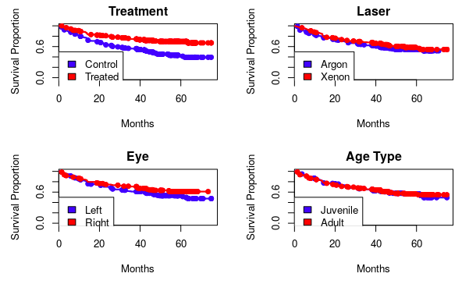
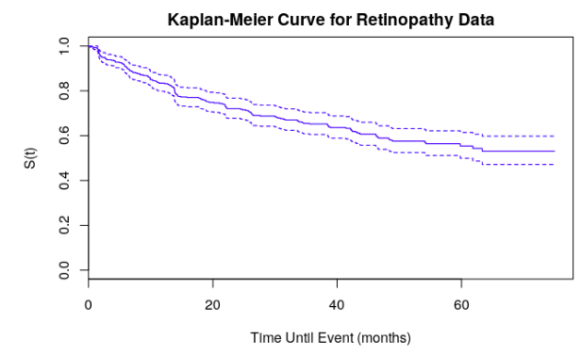
Survival curve

Slide 4
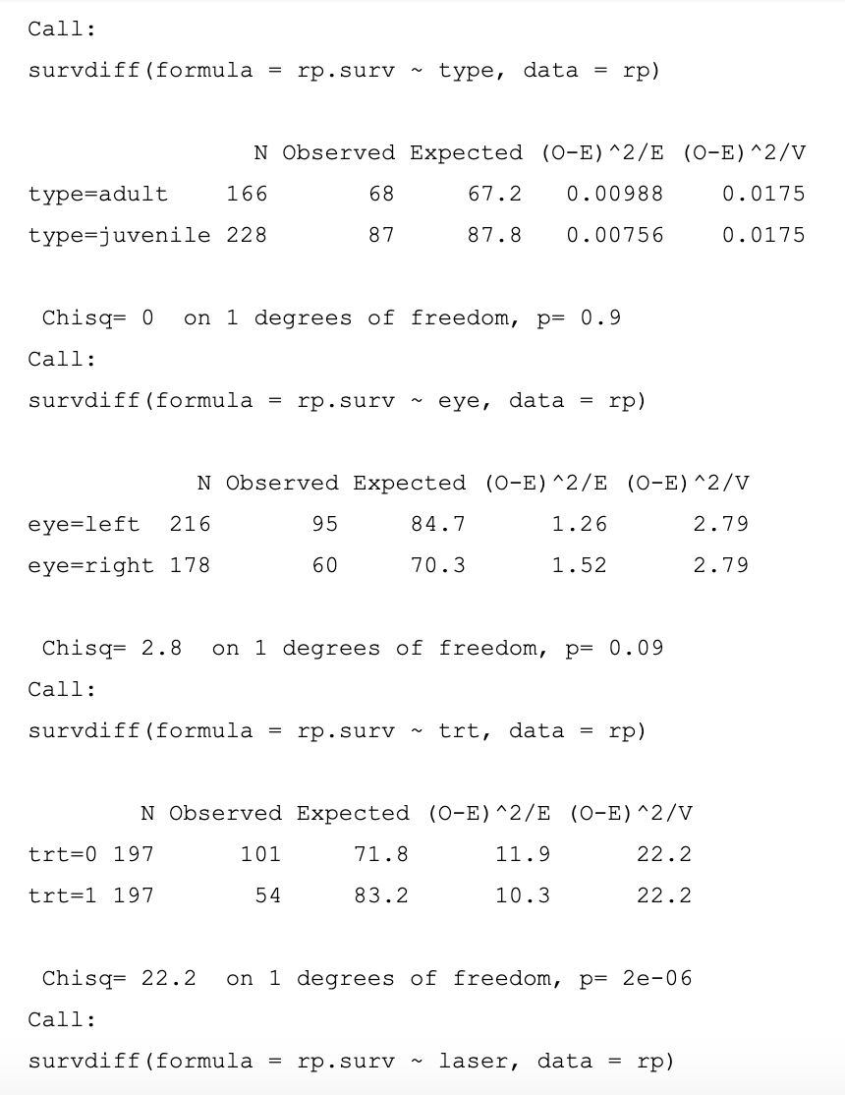
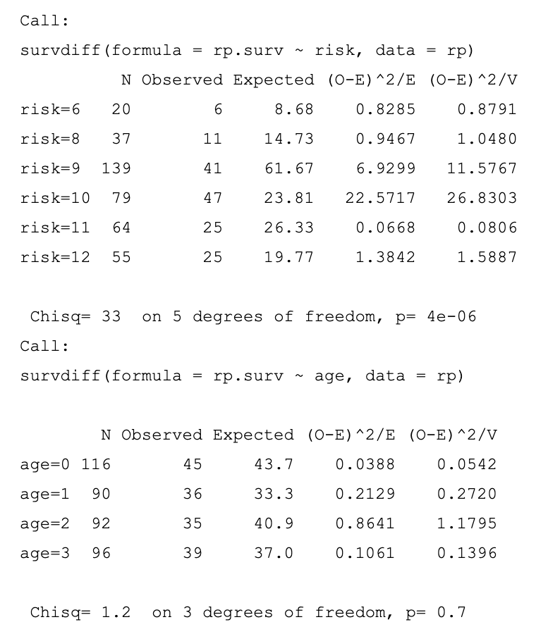
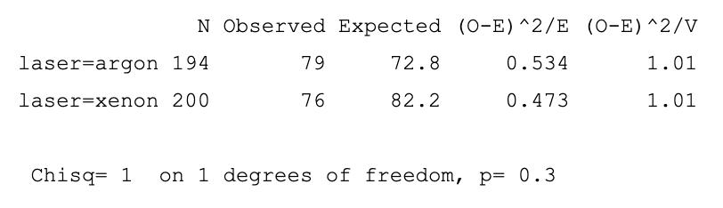
Log Rank Test

Slide 5
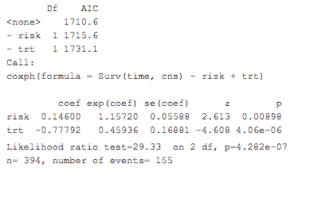
AIC selection
We are using both backward elimination method and forward stepwise selection method to pick the right set of covariates. First we build a full model with all covariates. Then we can use the function “step” in R to apply backward elimination. It shows that the risk and trt are the two significant variables.

Slide 6
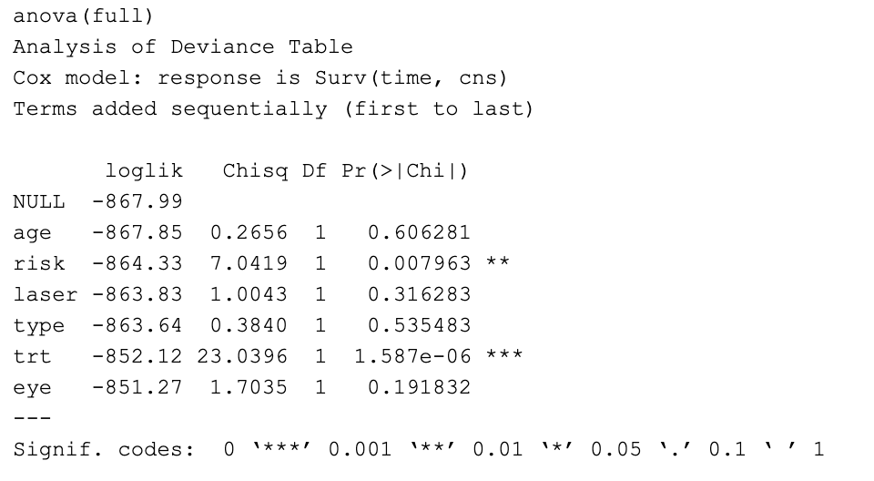
Model Checking

Slide 7
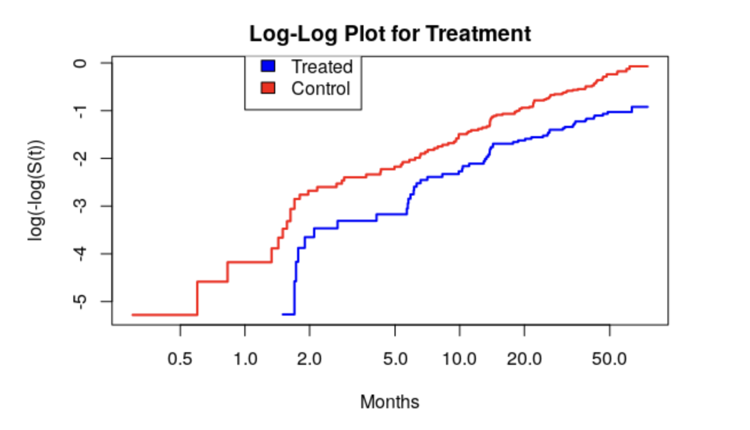
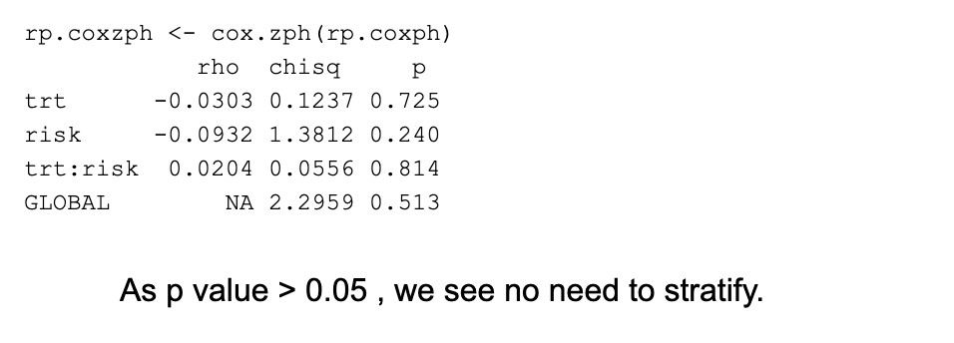
Residual Test

Slide 8
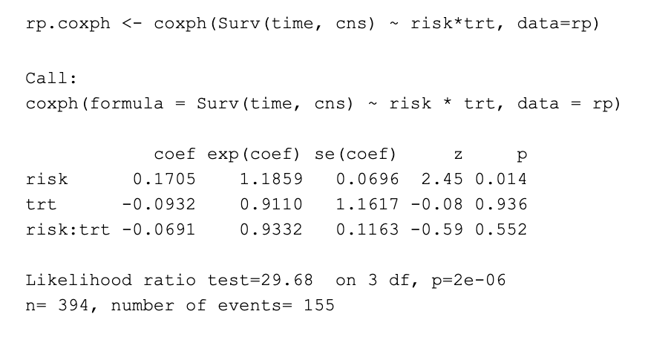
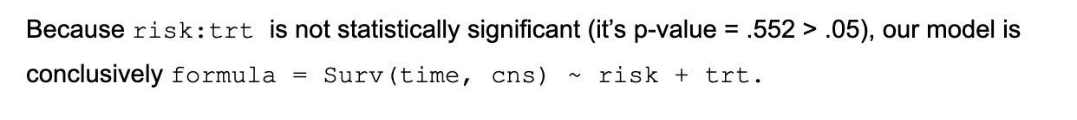
Interaction Term

Slide 9
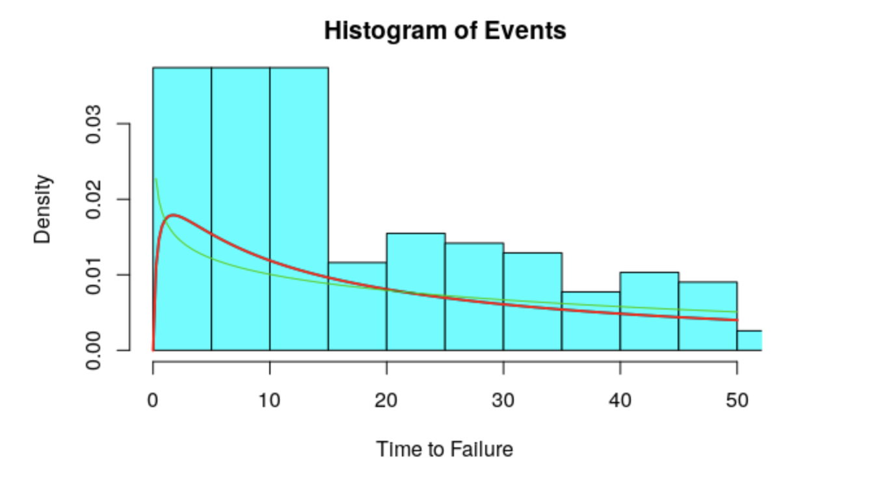
Extension: AFT Model

Slide 10
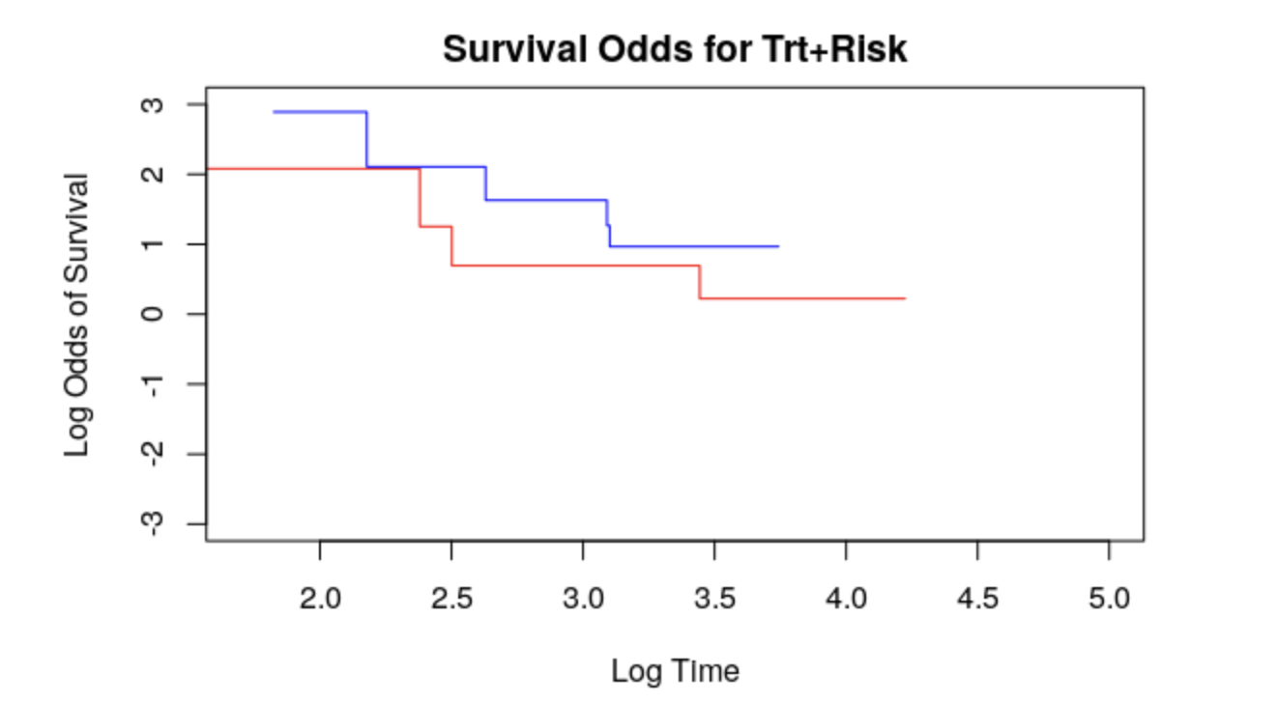
Survival Odds for Treatment and Risk

